Slide 1
OPERATIONS
BUSINESS FUNCTIONAL AREA

Slide 2
INTRODUCTION
TYPES OF OPERATIONS
PROCESSES
OPERATIONS MANAGEMENT
PRODUCTION MANAGEMENT
BENEFITSOF DIGITALISING OPERATIONS
DIGITALISATION PROCESS
REFERENCES

Slide 3
INTRODUCTION

Slide 4
WHAT IS OPERATIONS
Operations is the work of managing the inner workings of a business so it runs as efficiently as possible. Whether a business makes products, sell products, or provide services, every small business owner has to oversee the design and management of behind-the-scenes work.
The specific definition of operations will depend on the industry and the stage of business maturity. Sometimes, improving operations means thinking strategically about and processes. Other times, it means being part of the on-the-ground work to bring every aspect of a project, from tiny to huge, to reality.
What is “digital operations”? Most simply stated, it is weaving a digital thread across business processes in order to support the management of the end-to-end customer and employee experience across the entire business lifecycle.
The Boston Consulting Group (BCG) says “Digital Operations focuses on the customer journey and the end to-end business process, and not only the IT operations that support it.”

Slide 5
IMPORTANCE OF OPERATIONS
Typically, SMEs manage to sustain themselves because of:
their adaptability and agility,
close proximity to their customers,
their openness towards new ways of working, and
their risk-taking approach,
Many MSMEs are susceptible to major challenges because of operational risk-which is the potential loss resulting from inadequate or flawed internal processes, people and systems, or external events. This calls for SMEs to attain the highest levels of efficiency in business processes to stay competitive. Operational excellence plays a buffer to these risks.
On adopting principles of operations management, SMEs can maximise insights from their company data using real-time reports, maintain and improve customer relations which are even more significant for smaller organisations, allow for greater flexibility, decrease cost of producing goods and services, boost revenue, increase productivity, and prepare for future innovation relying on a solid base of operations skills and knowledge.

Slide 6
TYPES OF OPERATIONS

Slide 7
RETAIL BUSINESS
The daily goal of a retail business is to stock the items customers want at a price they’re happy to pay.
For operations, that means perfecting inventory.
Records reveal what is selling well, and what’s sitting, unwanted, on the shelves? Can an SME negotiate lower prices or better terms from vendors? Would customers be willing to pay more for any of the items being sold?
While some of the answers will be obvious upon crunching the numbers and analyzing the results, another operational update might be to implement a software program that can manage and optimize your inventory in real time so an SME can address these questions more quickly and more often.

Slide 8
RESTAURANT
Food businesses have even more challenging inventory problems than retailers, since their product is perishable. At a restaurant, operations applies not just to foodstuffs, but also purchasing, preparation, and the costs of food, beverage, and labor. Restaurants are also concerned with customer service and customer experience at your restaurant.
As SME’s look to streamline processes, a good opportunity would be to sign contracts with important suppliers, improving the organization of walk-in refrigerators to optimize food freshness, or training staff to exceed customer expectations. Think through who should be in charge of leading the different aspects of operations, since it likely won’t fall to one person.

Slide 9
SERVICE COMPANY
Service companies can divide their operations into two key buckets: client-facing and business related.
Start by thinking through client interactions: what could happen more quickly? Is the customer experiencing any unnecessary notifications?
Then, consider how current processes for communicating, collaborating, and managing projects affect the service offering. For example, if client projects are continually coming in over budget, one big operational concern would be the methods used to calculate estimates at the beginning of a job.

Slide 10
PRODUCTS
The origin of the term “operations” comes from companies that made physical goods.
Back when economies were industrializing, inventive businesses tried to add efficiencies wherever possible. That led entrepreneurs like Eli Whitney to pioneer the method known as parts-based assembly, so that cotton gins and other products could come to market more rapidly, cheaply, and consistently.
You don’t have to reinvent the assembly line if your small business makes products, but you should take a good look at how you purchase, store, make, and ship your merchandise.
Consider methods from a time standpoint: Is there a way to consolidate big orders to save time by working in bulk? Are there bottlenecks in production that might have simple solutions? Could transportation be improved upon? Could the SME negotiate better with suppliers?

Slide 11
DIGITAL COMPANY
Much of a digital company’s value lies in personnel.
Operations has a lot to do with finding optimal ways of hiring, training, and mentoring your staff. Tools to help with employee retention and satisfaction are wrapped into this, too.
With digital products, collaboration is key; most sites, apps, or tools can’t work properly without the help of multiple teams. That means that monitoring processes and updating software as needed to streamline collaboration is an operational necessity.
Another matter to pay attention to is outsourcing: what should full-time employees spend their time on, and what types of tasks are best left to external experts?

Slide 12
ACTIVITY
GROUP ACTIVITY
Share with your group the type of business you are in, what operations you perform and how you go about producing the good and services for your customers.
In your discussion focus on day to day activities, the equipment employed, the people and skills employed and the different processes involved in your businesses operations.

Slide 13
PROCESSES

Slide 14
PROCESSES IN OPERATIONS
Operations is where inputs (factors of production) are converted to outputs (goods and services). Operations is like the heart of a business, pumping out goods and services in a quantity and of a quality that meets the needs of the customers. The operations manager is responsible for overseeing the day-to-day business operations, which can encompass everything from ordering raw materials to scheduling workers to produce tangible goods.
Making and Distributing the Product
If your business produces and distributes a physical product, you need to oversee the process of creating that product from start to finish.
Receive orders and set production numbers
Monitor and improve workflow
Maintain and repair equipment
Package and store finished product

Slide 15
OPERATIONS MANAGEMENT

Slide 16
OPERATIONS MANAGEMENT
Operations management is concerned with planning, organizing, directing, and overall control of all activities within the organization. This is the primary function of operations management and will effectively aid in converting raw materials and human efforts into a durable good and service that consumers will be able to utilize. Operations within production must be scheduled in a way that minimizes the amount of setup required and maximizes the utilization of resource capacity. If this is achieved, the production facility will be able to increase its production output.
An important part of operations management is production planning. Production planning allows the firm to consider the competitive environment and its own strategic goals to find the best production methods. Good production planning has to balance goals that may conflict, such as providing high-quality service while keeping operating costs low, or keeping profits high while maintaining adequate inventories of finished products. Sometimes accomplishing all these goals is difficult.

Slide 17
OPERATIONS MANAGEMENT
If you run a small business, and you’re struggling to manage the resources you need for your products and services, then deploying an operations management strategy and cloud-based software can help. There are a lot of benefits to gain from doing this, including:
Decreasing the costs of producing products and services
Increasing customer satisfaction through good quality and service
Boosting revenue
Increasing operational effectiveness
Providing the basis for future innovation by building a solid base of operations skills and knowledge.

Slide 18
PRODUCTION MANAGEMENT
Production and operations management involve three main types of decisions, typically made at three different stages:
Production planning. The first decisions facing operations managers come at the planning stage. At this stage, managers decide where, when, and how production will occur. They determine site locations and obtain the necessary resources.
Production control. At this stage, the decision-making process focuses on controlling quality and costs, scheduling, and the actual day-to-day operations of running a factory or service facility.
Improving production and operations. The final stage of operations management focuses on developing more efficient methods of producing the firm’s goods or services.

Slide 19
ACTIVITY
GROUP ACTIVITY
Identify the processes in your businesses operations.
In your teams share the list of your processes and compare with those of your group members.
Discuss different ways of performing processes that are realistic and achievable.

Slide 20
PRODUCTION MANAGEMENT

Slide 21
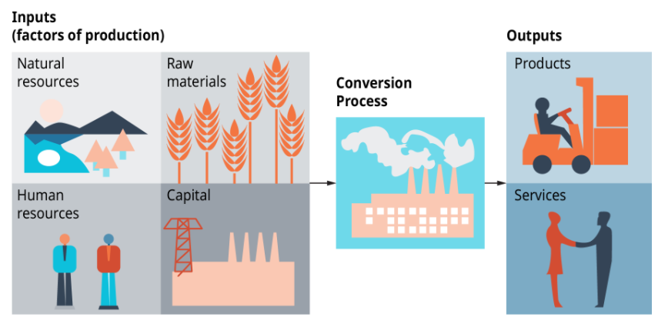
PRODUCTION

Slide 22
PRODUCTION PLANNING
Production planning involves three phases. Long-term planning has a time frame of three to five years. It focuses on which goods to produce, how many to produce, and where they should be produced. Medium-term planning decisions cover about two years. They concern the layout of factory or service facilities, where and how to obtain the resources needed for production, and labor issues. Short-term planning, within a one-year time frame, converts these broader goals into specific production plans and materials management strategies.
Four important decisions must be made in production planning. They involve the type of production process that will be used, site selection, facility layout, and resource planning.
What are the three types of decisions that must be made in production planning?
What are the three phases of production planning?

Slide 23
BENEFITS OF DIGITISING OPERATIONS

Slide 24
FASTER MANUFACTURING
Manufacturing will move a lot faster
The first thing we're seeing as digitization transforms the manufacturing industry is the speed of manufacturing. Driven by rapidly changing consumer tastes and an accelerated pace of new product introduction/innovation, manufacturing needs to figure out the best way to adapt.
Digitization gives an instant boost to productivity, allowing projects to move faster and manufacturers to hit more aggressive deadlines.
Specifically, manufacturers will be able to rapidly move from design to floor and back again as changes come through from the engineering team.
Right now, this process is extremely manual in many circumstances. 3D designs are converted into 2D spec books, and then those books are delivered to machinists on the floor who review and "redline" (literally mark up) the books.

Slide 25
WHAT IS MAINTENANCE MANAGEMENT
Then those books are returned to engineering teams for revisions.
And within that process is a lot of inefficiencies:
Printing a spec book might take hours with complicated designs
Delivering is fine if the floor is below you. But what do you do when the factory is half a world away?
Redlining need to be done page by page, rather than simply reviewing the changes
And the whole process is manual. There's no auto-check and no opportunity for further innovation to optimize the process.
Digitization makes this process more efficient by solving these problems. And opens the door for modern manufacturing innovation.

Slide 26
THE IoT
Digitization is the greatest step towards the Industrial Internet of Things (IIoT)
The Industrial Internet of Things is a dream of a total product data loop.
First, machines are loaded with sensors when they're built. Then, those sensors provide continuous feedback throughout the manufacturing supply chain. In response to real-world data about things like maintenance requirements and wear and tear, the manufacturing process can be refined.
Some refinement happens automatically (machine-to-machine communication) but some data is fed into business intelligence (BI) tools and dashboards, giving people the ability to find efficiencies.

Slide 27
WHAT IS MAINTENANCE MANAGEMENT
The crux of this whole process, however, is data. Data that can be collected and leveraged on a truly staggering scale.
And that data can only be reasonably collected and managed if it's an entirely digital product:
Designs can be changed automatically in response to environmental challenges
Changes can be pushed automatically to the manufacturing floor
Products can be altered as they roll off the line.
Eventually, we may reach a point where automation and AI continuously optimize existing designs in response to real-world circumstances, leaving engineers to focus on the innovation of new products.

Slide 28
COMBINED VALUE CHAIN
United manufacturing processes
We mentioned earlier the fact that a major problem of analog processes is that organization struggle if they're manufacturing across multiple locations.
And since the manufacturing is now a global industry, this is a huge problem.
Digitization can offer much-needed relief for global manufacturing value chains for a few reasons.
First, data is easier to share. It's much easier to share files across a network then it is to send files through the mail. Even if the files are sent and then printed out, that's another data translation, and thus another vulnerability for the organization. However, this is only possible if:
Organizations can share data essentially in real time across multiple global locations.
If all the necessary data can be accessed by anyone, at any time.

Slide 29
WHAT IS MAINTENANCE MANAGEMENT
Rapid iteration will become the norm
Digitization won't only make manufacturing faster. One thing we're already seeing is it driving innovation through rapid product iteration.
Better data sharing across divisions, organizations, and software suites via APIs will only fuel this iteration speed.
By flattening silos and enabling data to be accessed in real time, anywhere in the world, organizations are poised to act on innovation trends, market opportunities, and consumer demands like never before.

Slide 30
ACTIVITY
GROUP ACTIVITY
Do you think digitalisation will benefit your business? Share your thoughts with your group.

Slide 31
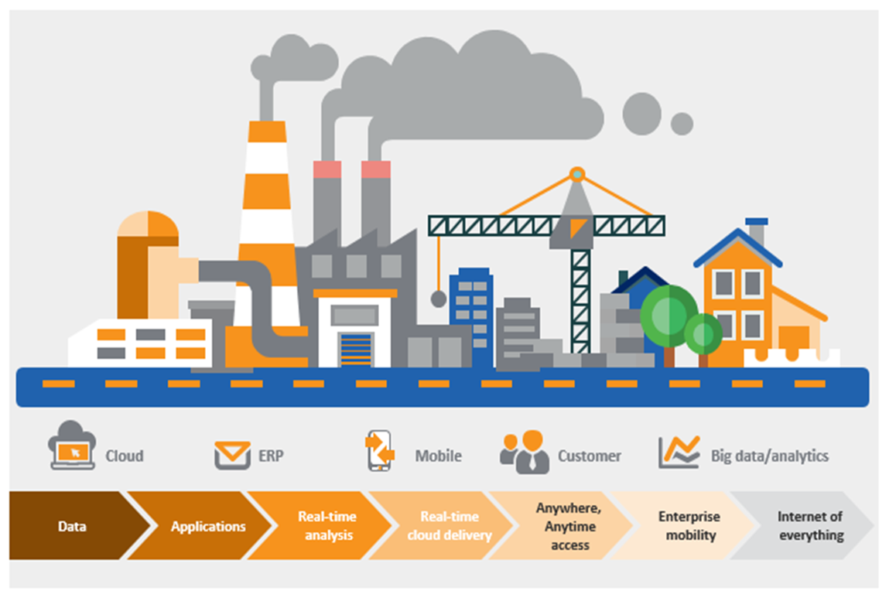
DIGITAL MANUFACTURING

Slide 32
DIGITISATION PROCESS

Slide 33
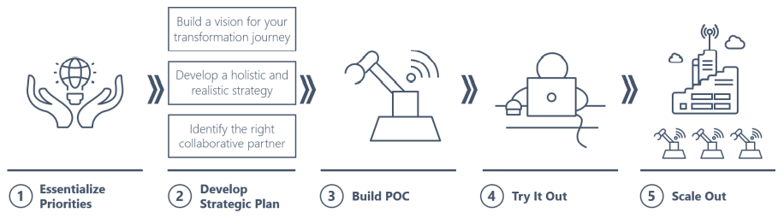
MAINTENANCE STRATEGY

Slide 34
ALIGN STRATEGY AND TECHNOLOGY
Taking a holistic approach to business and technology from the outset is critical, as it makes a major positive difference in the timeline, cost and outcomes of a digital transformation effort. In contrast, pursuing a strategy independent of technology considerations invites unnecessary risk. When a firm goes down the path of developing a strategy without realizing the full potential of technology, it’s all too common to find that there is a gap. For example, a strategy may seem promising, but may ultimately not be fully realized. When this happens, a digital transformation initiative must be rescoped, which means wasted time and investment.
An integrated approach that incorporates both strategy and technology greatly reduces this risk

Slide 35
TAKE AN AGILE APPROACH
Agility is another critical success factor, since an agile, incremental approach ultimately helps firms realize more value from digital transformation efforts. Too often, when consultants are brought in to lead transformation, the result is an unwieldy project that fails to get traction due to its massive scope.
Instead, it is more effective to develop an overall strategy at a portfolio level, and then break it down into individual projects. This enables a focused initial scope that can be expanded over time. Ultimately, the success or failure of digital transformation depends on how technology and process changes function under real-world conditions. That’s why it’s critical to focus an initial project on a proof of concept (POC) to support rapid learning and iteration.
Using a POC to prove, refine or refactor objectives is an agile foundational method that makes it possible to achieve results in a shorter timeframe and build a roadmap forward. It also provides the opportunity to improve or enhance the plan as needed to create long-term change

Slide 36
ENSURE RELEVANCE TO YOUR BUSINESS
Ensure relevance to your business
A strategy that reflect your industry business is essential. Not all business have the same needs when it comes to digital transformation. The aerospace industry has specific challenges and opportunities, some of which, but not all, are shared by other business. It’s important to be able to draw upon expertise that’s specific to your business to ensure you’re taking advantage of all possible opportunities offered by digital transformation. A business-oriented approach can even be the difference between transformation and a stalled project. No matter which form of digital transformation you’re pursuing, the odds of a successful initiative increase when you think holistically about business and technology strategy, take an agile approach and apply a business-specific lens.

Slide 37
ACTIVITY
GROUP ACTIVITY
Tell your group members how you would about digitalising your business.

Slide 38
MY ASSETS
Does your business produce goods or services?
Is your business retail, restaurant, manufacturing or services?
Do you believe that technology deployment will improve operations?
Are you currently constrained by your inability to deliver goods or services?
Have you lost any business due to quality or unavailability?
Is your business able to handle 25% immediate growth in orders?
Do you have the skills in your business to digitalise your operations?

Slide 39
REFERENCES

Slide 40
REFERENCES
https://www.quora.com/What-is-the-difference-between-scheduled-and-unscheduled-maintenance-of-heavy-equipment.
Maintenance Management: An Overview; https://www.reliableplant.com/maintenance-management-31856
What is a CMMS? CMMS software improves efficiency by centralizing information and processes, https://www.emaint.com/what-is-a-cmms/#
Seven steps to maintenance strategy; https://www.maintenanceandengineering.com/2019/08/09/seven-steps-to-maintenance-strategy
A Step By Step Guide to Choosing the Right Maintenance Strategy for Your Equipment, https://www.onupkeep.com/blog/choosing-the-right-maintenance-strategy.
How to Apply the Correct Maintenance Strategy to Your Assets; https://www.reliableplant.com/Read/20854/maintenance-strategy-assets
Digital transformation of asset maintenance processes; https://retaintechnologies.com/en/digital-transformation-of-asset-maintenance-processes/

